Slide 1
Datums/Coordinates and Other Stuff • March 20, 2024
Notes:
Welcome and intro

Slide 2
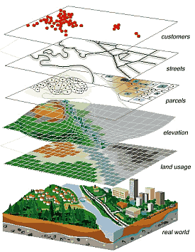
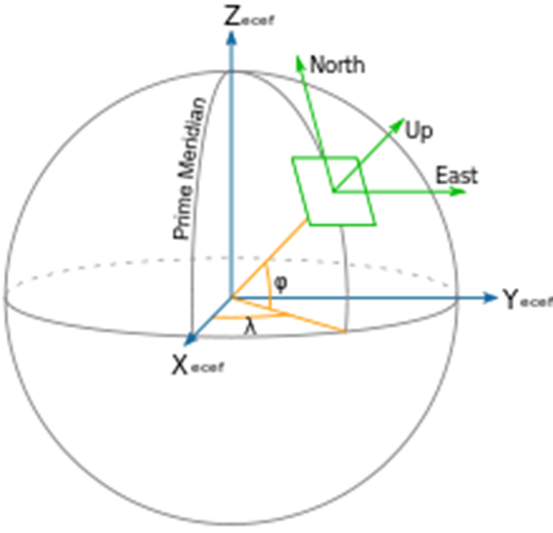
A Datum is a set of parameters that let us align our maps to their “true” location on the earth.
Notes:
Datums link maps to their specific location on the earth. Modern datums are based on the entire global model of its shape and gravity. Older datums made assumptions based on convenience and practical use.

Slide 3
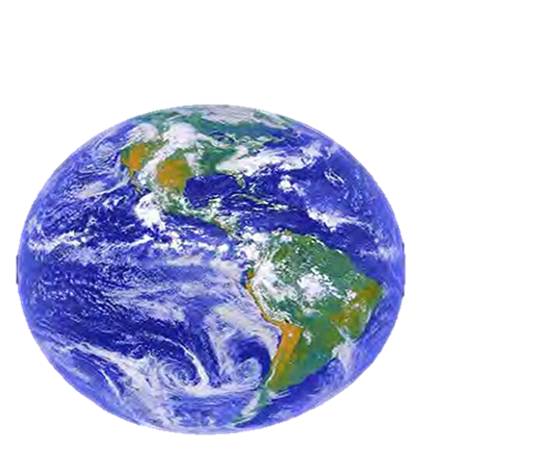
Non-geocentricity of NAD83
ITRF2014
GRS80 ellipsoid
NAD83
GRS = Geodetic Reference System
Notes:
-we’re going to back up and get to the non-egocentricity, stay with me here
-so there’s a nice little ellipse representing the shape of the GRS80 reference ellipsoid
CLICK
-what’s GRS80? well, it’s a reference system (being a reference ellipsoid, a gravity model, and more).
-GRS80 in itself is not a datum, although you will see/hear some folks misinterpret that
CLICK
-now once you take that reference system/ellipsoid and you tie it to the origin of your choice… badabing!
-now you’ve got a datum (or reference frame)
CLICK
-in this case, we’re talking about that blue which is symbolizing an ellipsoid with it’s origin locked to the Center Mass of the earth
-which represents the ITRF2014
-you may be thinking “jeff what is the ITRF?”… don’t worry we’ll get there for now the concept is more important
CLICK
-so now let’s look at how NAD83 compares, the orange there, see it’s shape is the same GRS80 ellipsoid… but with a different origin point
-not quite aligned to CM, but close… not bad, it was the 80s maaaan, they did the best they could!
-jokes aside, a pretty amazing feet to have only “missed the mark” by a few meters, they didn’t have the satellite technology or computer power we have back in the late 70s when the calcs for NAD83 were being run
-props to those folks!
CLICK

Slide 4
Non-geocentricity of NAD83
ITRF2014
GRS80 ellipsoid
NAD83
Notes:
--zooming in to setup for next slide—
-Let’s zoom in a little to examine that situation

Slide 5
Non-geocentricity of NAD83
Earth’s
Surface
h₁₄
h₈₃
NAD83
origin
ITRF2014
origin
~2.2 meters
GRS80
ellipsoid
Notes:
-so there’s one quarter of both the NAD83 and ITRF2014 ellipsoid
CLICK
-important to note that both are using the same geometry (size, shape), the GRS80 ellipsoid, just with a different origin
CLICK
-so that dark red [maroon if you will] arrow there on the bottom left, it symbolizes and greatly exaggerates the difference between those origins
CLICK

Slide 6
Non-geocentricity of NAD83
Earth’s
Surface
h₂₂
NAD83
ITRF2014
NATRF2022
GRS80
ellipsoid
Shift…
Notes:
-and we’ll visualize the plan to remove the non-egocentricity of NAD83 with a little animation
CLICK
-our orange NAD83 ellipsoid shift over to match up with out blue ITRF ellipsoid
-and now there we see the result in red, our new NATRF2022 ellipsoid
CLICK
-what do I like to point out here?
-we’re still utilizing the GRS80 reference ellipsoid as the basis for NATRF2022
-why? because the size and shape, well the scientists nailed it on that one, like I said earlier they just didn’t quite get the CM
CLICK

Slide 7
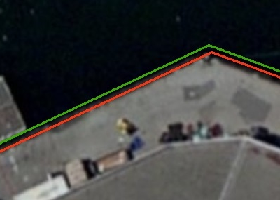
What’s that going to look like?
PHOTO = NAD83
RED = NAD83 shoreline data
GREEN = shoreline transformed to NATRF2022
Notes:
RED: NAD 83 coastline against NAD 83 imagery
GREEN: Coastline shifted into NATRF2022 but the imagery remains on NAD 83

Slide 8
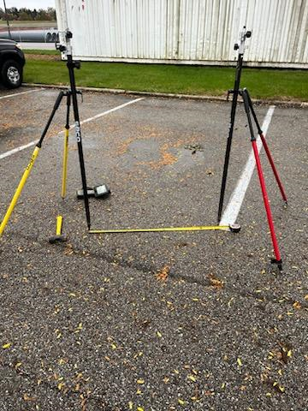
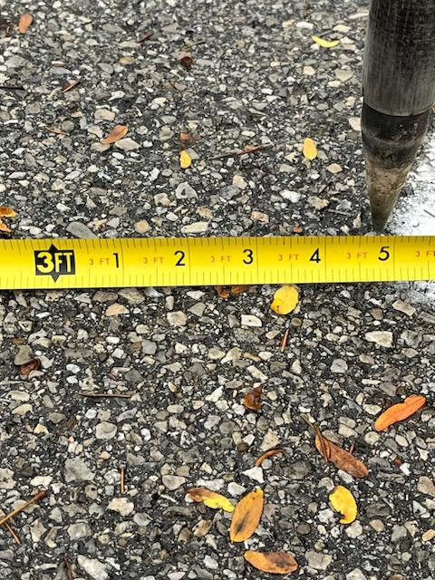
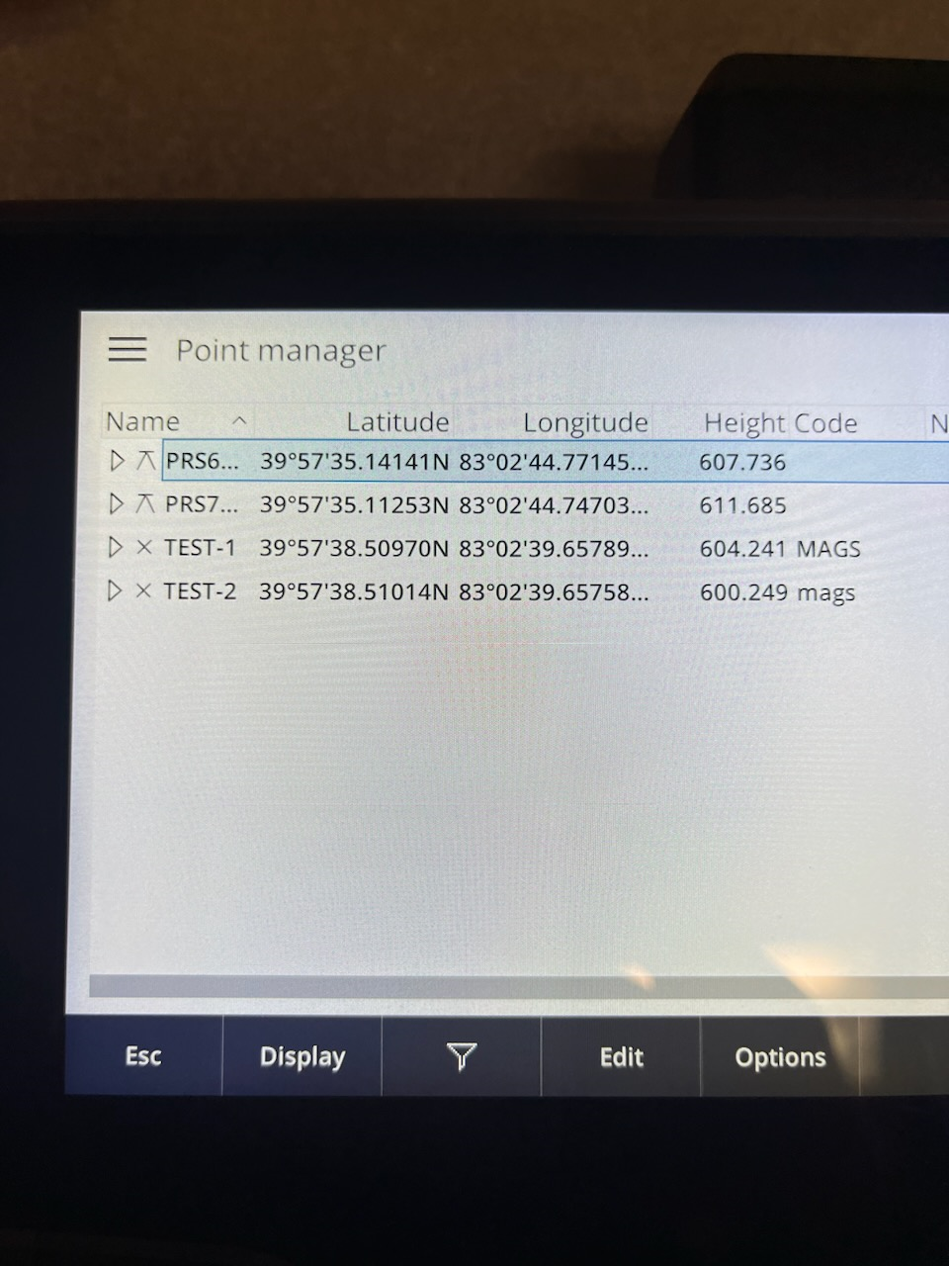
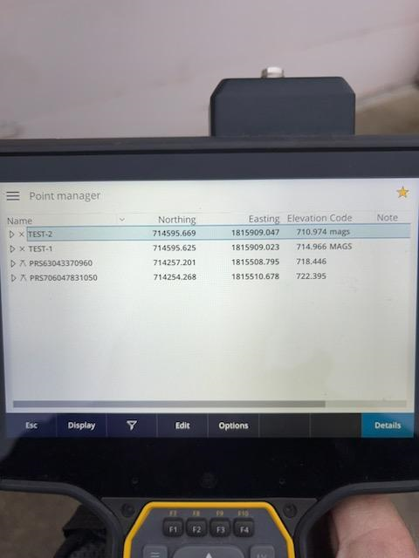
NATRF 2022
NATRF 2022
NAD 83 (2011)

Slide 9
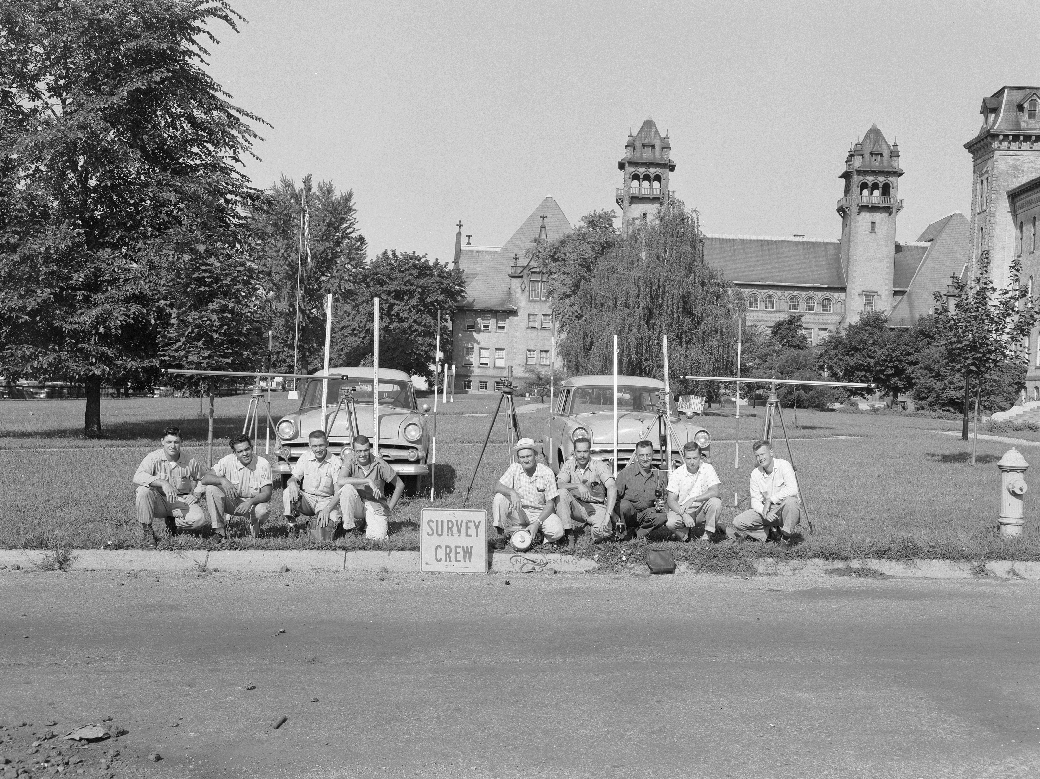
Vertical Datums

Slide 10
Replacing NAVD88
primary access via GNSS and geoid (OPUS, etc.)
accurate continental gravimetric geoid (1-2 cm)
aligned with:
  NATRF2022 (or CATRF, PATRF, MATRF)
  global mean sea level (GMSL)
monitor time-varying nature of gravity (NGS Geoid Monitoring Service GeMS)
Notes:
The goal stated in the NGS strategic plan is to achieve 2cm accuracy vertically with a 15 minutes GPS session.
Note the datum will be aligned to global mean sea level, not continental as with previous datums
Like I”d said, the community wants an easier to access, no need to go recover a BM, nationwide datum. GNSS is the most efficient way to accomplish that, which mean geoid-based ortho heights, which means gravity observations.
So let’s talk about that.

Slide 11
Two flavors of geoid models…
  Gravimetric
  Hybrid
Notes:
So… all the geoids you’re using to get elevations from your GNSS data

Slide 12
Gravimetric → Hybrid
  Gravimetric geoid is created from “scratch” with various types of gravity data
      USGG2003, USGG2009, USGG2012, xGEOID19
  Hybrid geoid is simply a gravimetric geoid warped to fit some vertical datum… like NAVD88
      GEOID03, GEOID09, GEOID12B, GEOID18
Notes:
So… all the geoids you’re using to get elevations from your GNSS data

Slide 13
Gravimetric → Hybrid
      USGG2003, USGG2009, USGG2012, xGEOID19
      GEOID03, GEOID09, GEOID12B, GEOID18
best fit to NAVD88
best fit to NAVD88
best fit to NAVD88
best fit to NAVD88
Notes:
So… all the geoids you’re using to get elevations from your GNSS data

Slide 14
Which NAD83 with which geoid?
Geoid18
Geoid12A/B
NAD83(2011) →
NAD83(2007) →
NAD83(HARN/FBN)
NAD83(CORS96)
Geoid09
Geoid06 (AK only)
Geoid03
Geoid99
Geoid96
Notes:
SIDEBAR!

Slide 15
Individual Components of NAPGD2022
Global Model of the geopotential field
  GM2022
Geoid undulation models by region
  GEOID2022 aka “0 elevation”
Deflection of the Vertical (DoV) models by region
  DEFLEC2022
Surface Gravity models by region
  GRAV2022
Notes:
GM2022 - a spherical harmonic model of Earth’s external gravitational potential (energy)
-these items each will have both a static version and a dynamic version that will be published
So all those models work together to get you a 2cm height with a 15 minutes GNSS session

Slide 16
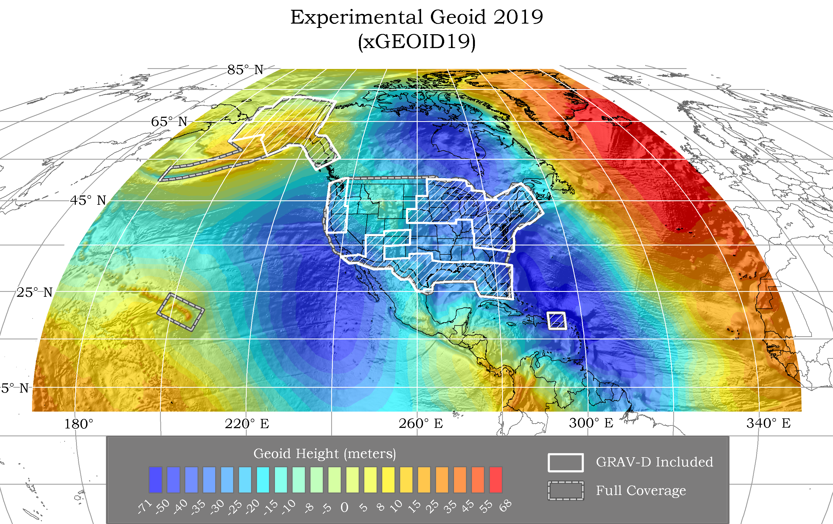

Slide 17
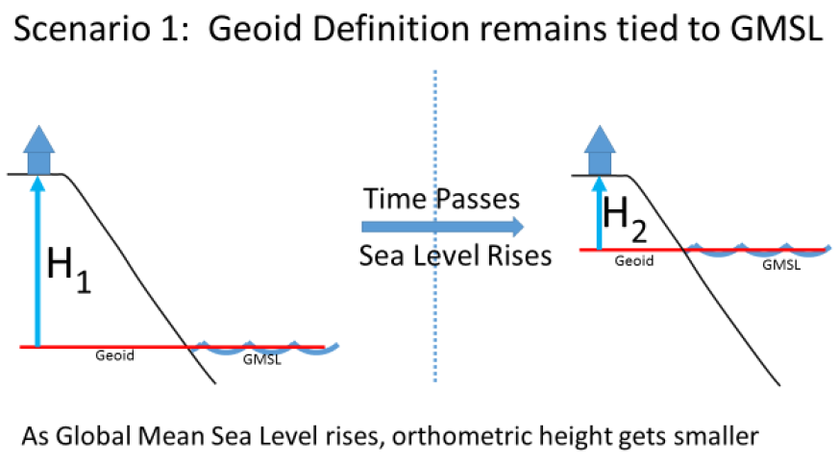
Sea Level Change and the Geoid
Notes:
Is that what we want? Continuously changing elevations?
No, not many folks anyway. It’s too dynamic for almost everyone’s purposes/

Slide 18
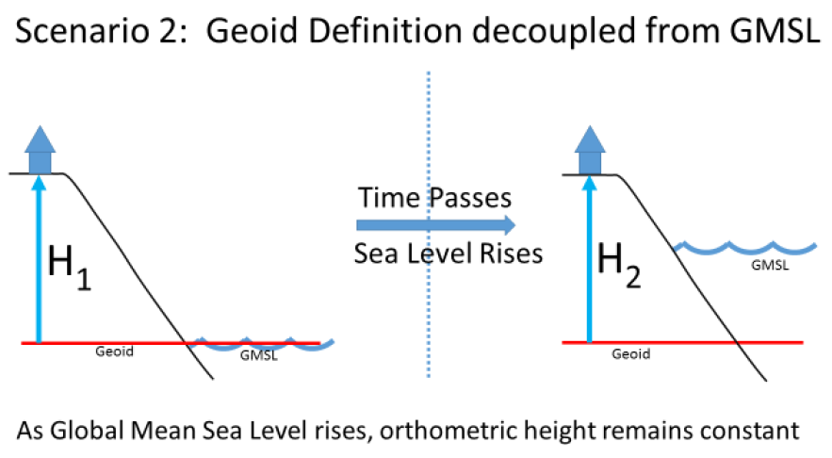
Sea Level Change and the Geoid
Notes:
Is this what we want?
Stable ground elevations even though global water levels are rising?
No, think about flood mapping of coastal areas? This would make it extremely difficult to maintain FEMA NFIP and other flood-related programs.

Slide 19
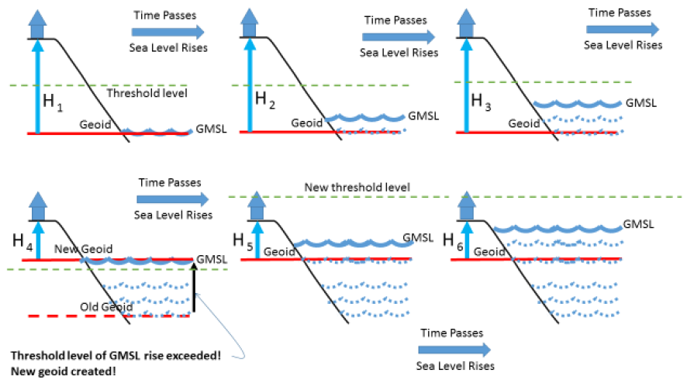
Sea Level Change and the Geoid
Notes:
The illustrated strategy will be adopted at NGS. Again, a graphic characterization of this approach
What this means is that NGS will adopt Scenario 2, decouple geoid, until the geoid and GMSL have diverged by some threshold amount, currently defined as 20cm.
When that threshold is reached a new geoid will be defined and held fixed until reaching next threshold. In this way, the impact of the change of GMSL is accounted for in the heights of the NSRS, while the appearance of stability is maintained for “decades at a time” (BP2 Section 14).
If we calculate how long that might be based on existing rates of sea level rise of 3ish mm/yr then we’re talking about 50 years

Slide 20
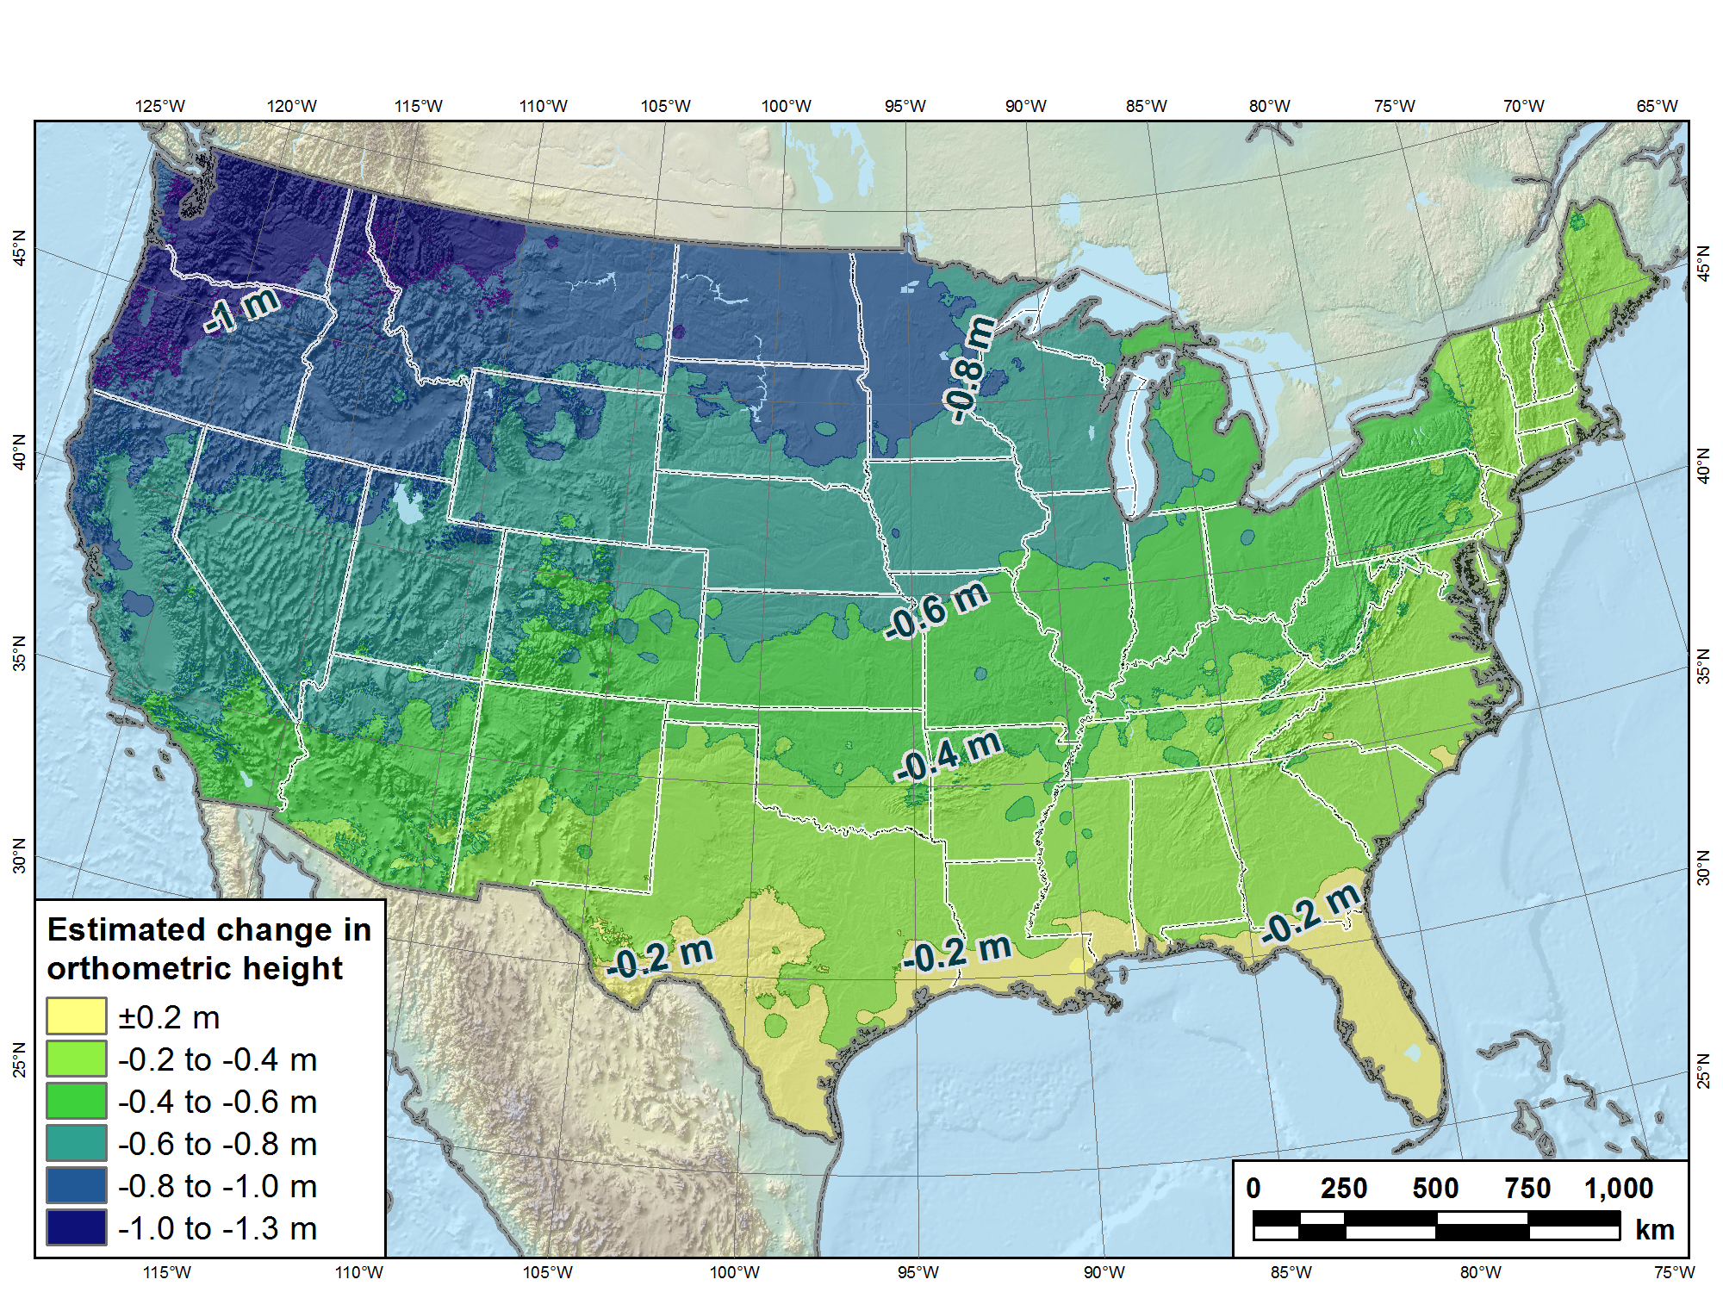
Estimated change in orthometric heights from NAVD88 to NAPGD2022
(NAPGD2022 approximated using xGEOID16B)

Slide 21
Estimated change in orthometric heights from NAVD88 to NAPGD2022
(NAPGD2022 approximated using xGEOID16B)
Vertical change of about -0.6 to -2.0 feet
Notes:
Previously estimated values are matching xGEOIDs!
I have that estimate down there, and that’s true except for that little area, not sure what that’s all about, hard to get answers from the Geoid Team since the shutdown. They’re behind schedule but working frantically to get back on track.

Slide 22
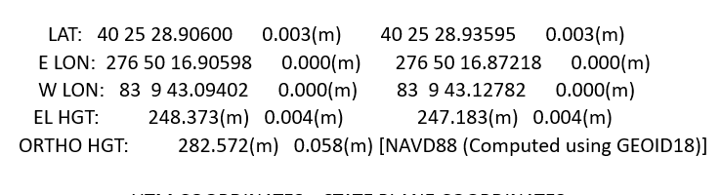
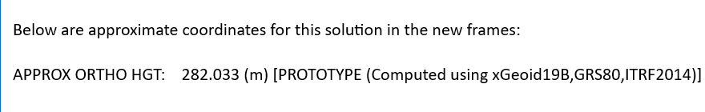
NAPGD 2022 vs. NAVD 88
H = -1.77 usft

Slide 23
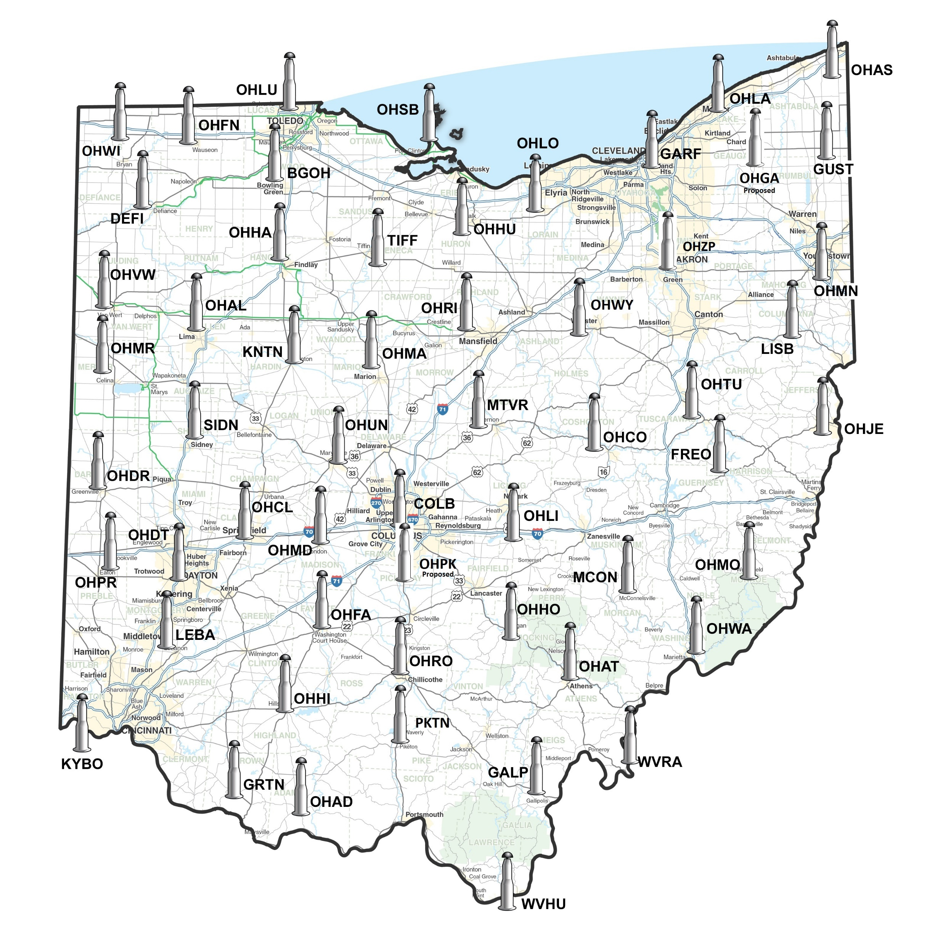
What is CORS?
CORS stands for “Continuously Operating Reference Stations”.
The ODOT CORS network consists of 42 GNSS receivers owned by ODOT and an additional 12 GNSS receivers owned by other entities such as the Kentucky Transportation Cabinet and West Virginia DOT. We also have data sharing agreements with Indiana and Michigan DOT’s that help strengthen our network.

Slide 24
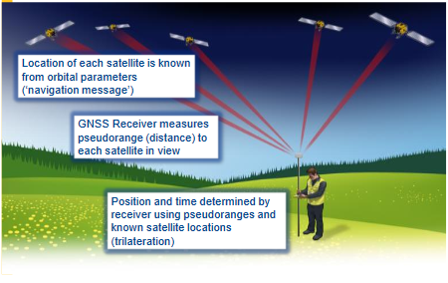
What does the CORS Network do?
The GNSS receivers in the CORS network collect positional data 24/7/365.
By doing so over a long period of time we now have very accurate locations for all CORS stations in our network.
GNSS Positioning Principles

Slide 25
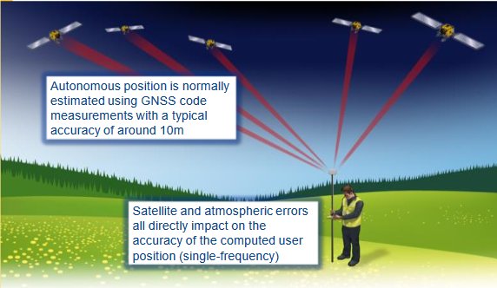
Survey Position Accuracy
Autonomous Positions: (what you would typically get from your cell phone for example) have a typical accuracy of around 30 feet.
Position inaccuracy is caused by the satellite signal passing through the ionosphere and troposphere causing delays in the signal.
The satellite signal is also affected by objects on the earth such as buildings and trees creating multipath and loss of signal situations that affect positional accuracies.
Autonomous Positioning - Mapping and GIS

Slide 26
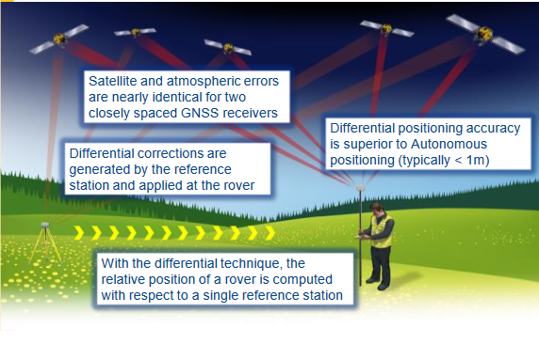
How do we get better accuracy?
Differential Positioning (RTK)
Using the CORS stations we can now calculate the satellite and atmosphere errors (the delay in the satellite signal thru the ionosphere and troposphere) and apply those corrections to our “roving” GNSS receiver to obtain better accuracies.
Differential Positioning - Using corrections

Slide 27
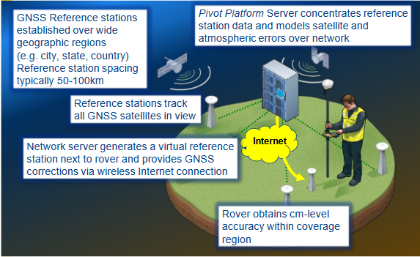
How do I get my corrections?
The CORS Network is only one piece of the puzzle!
The CORS stations are spaced 20 to 50 miles apart and, as stated before, constantly collect data from the United States (GPS) and Russian (GLONASS) satellites. The data from the stations are sent to a server where Trimble Pivot Software synchronizes the data and models the atmospheric errors over the entire network.

Slide 28
How do I get my corrections?
Here is how you get an accurate position!
When you (the rover) want to establish an accurate position you need to contact the Pivot server and let it know your autonomous position (30 feet).
The Pivot software knows the atmospheric corrections for your location and sends you a “Virtual Reference Station” within 30 feet of your receiver. This “VRS” base provides you with GNSS corrections through a wireless internet connection.
Now you have a corrected accurate position +/- 1 cm!!!
As you move the “VRS” base follows you!!!

Slide 29
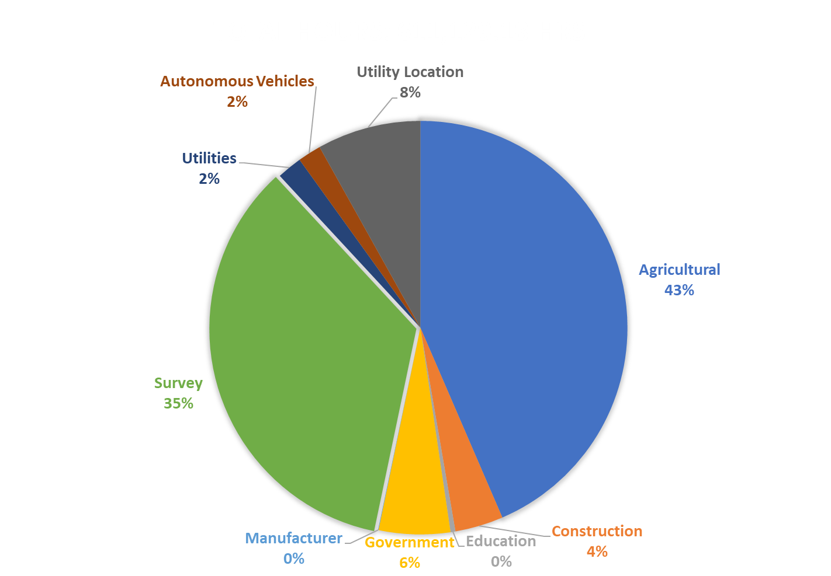
2022 Hours by classification

Slide 30
What can I do to prepare for the change?
The ODOT Real Time Network will continue to broadcast corrections on NAD 83 for a short period of time AFTER NGS switches to NATRF 2022. Most likely until November/December of the year after implementation.
The IP address that you currently use will not change 156.63.133.115. Ports will change from our current 2101 to 2 new ports, one broadcasting NATRF 2022 corrections and the other broadcasting NAD 83 corrections, forcing users to decide which datum they want to be on.
If you can switch to NATRF 2022 you can change to the port broadcasting that correction and not have to change settings again for the foreseeable future. This is HIGHLY recommended!
If you have projects on NAD 83 that you need to finish or transform to NATRF 2022 we will have a port broadcasting NAD 83 corrections to assist you in converting them. Once you have them transformed you will need to switch to the NATRF 2022 port.
REMEMBER! YOU HAVE LESS THAN A YEAR TO DO THIS! DON’T PROCRASTINATE!

Slide 31
When will ngs make the switch?
“Beta Version” of reference frames and OPUS will be released
6 Month period of testing and public comments.
After testing…up for Vote by FGCS to adopt as the official datum
What does this mean? Can they vote no?
FGCS will issue a FRN officially announcing adoption of the modernized NSRS

Slide 32
When will ngs make the switch?
After Voting…6 month roll out period for adoption.
All Modernized NSRS components will be moved from Beta to the live website and NAD 83 components move to Beta website
Will not be able to submit data to the NGS IDB after this happens

Slide 33
When will ngs make the switch?
We will NOT implement NATRF 2022 or NAPGD 2022 until the FGCS Vote!
But remember when we do you won’t have much time to transition projects!

Slide 34
State Plane Coordinates
Three common coordinate systems used in GIS
Geographic (Lat-Long)
UTM (Universal Transverse Mercator)
State Plane Coordinate System (SPCS)
SPCS Projection is either Transverse Mercator(cylindrical) or Lambert (conic)

Slide 35
Coordinates 101
Projection types
Projections convert spherical coordinates (latitude-longitude) to planar coordinates.
Three fundamental types of projections:
  –Azimuthal: projection onto a planar surface
  –Cylindrical: projection onto a cylinder, which is then ‘unrolled’ to a plane.
  –Conic: projection onto a cone, which can be unrolled to a plane.
All projections create distortions of either shape, area, distance, or more than one of these.

Slide 36
Coordinates 101
State Plane Coordinates (SPCS)
Specific system for each state
Some states divided into multiple zones with different grid systems for each zone.
Ohio has two zones: north and south
Most property maps (plat maps; tax maps), zoning maps, etc. are in State Plane Coordinates.

Slide 37
Coordinates 101
LATITUDE 41° 42’ N
NORTH ZONE
1st Standard Parallel: N 40° 26’
2nd Standard Parallel: N 41° 42’
Origin LAT: N 39º 40’
  X=600,000 m, Y=0 m
CENTRAL MERIDIAN
LONGITUDE 82° 30’ W
SOUTH ZONE
1st Standard Parallel: N 38° 44’
2nd Standard Parallel: N 40° 02’
Origin Lat: N 38º 00’
  X=600,000 m, Y=0 m

Slide 38
Coordinates 101
Linear distortion due to Earth’s curvature
Ellipsoid
Grid length greater
surface
than ellipsoidal length
Projection
(distortion > 0)
surface
(secant)
Grid length less than
ellipsoidal length
(distortion < 0)
Maximum projection zone
width for balanced positive
and negative distortion

Slide 39
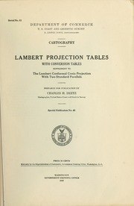
Coordinates 101
The Grid scale factor is the measure of the linear distortion that has been mathematically imposed on ellipsoid distances so they may be projected onto a plane. At a given point the ratio of the length of linear increment on the grid to the length of the corresponding increment on the ellipsoid is identified as the grid scale factor at that point.
The grid scale factor is constant at a point regardless of the azimuth in conformal map projections.

Slide 40
Coordinates 101
Linear distortion due to Elevation
Ground
surface
Ellipsoid
Grid length greater
surface
than ellipsoidal length
Projection
(distortion > 0)
surface
(secant)
Grid length less than
ellipsoidal length
(distortion < 0)
Maximum projection zone
width for balanced positive
and negative distortion

Slide 41
Coordinates 101
Surface of the Earth
A
h
B
B’
A’
A’B’ R
AB R + h
=
R
h = 500 ft.
Grid distance = 5000 ft.
R = Radius of Earth (20,906,000 ft.)
h = Ellipsoid Height
A’B’ = Points on Ellipsoid (GPS Positions)
AB = Positions on Earth’s surface
AB = 20,906,000
20,906,000+500
1
(5000)
Ground distance= 5000.12 ft.

Slide 42
Coordinates 101
Remember! Scale factor formulas and projection tables were developed before GPS! They were designed to reduce conventional traverses surveyed on the Ground to Grid distances. With GNSS equipment we are now working on the ellipsoid surface, computing Grid positions and now need to transfer them to the actual Ground surface!
A
h
B
B’
A’
R

Slide 43
Ohio Revised Code
157.03 Plane co-ordinates; description
Coordinates 101
The plane co-ordinates of a point on the earth’s surface, to be used in expressing the position or location of such point in the appropriate zone of the systems specified in section 157.01 of the Revised Code, shall consist of two distances, expressed in United States survey feet and decimals of a United States survey foot when using the Ohio co-ordinate system of 1927, and expressed in meters and decimals of a meter when using the Ohio co-ordinate system of 1983…
We find the practice of having Grid coordinates in meters and Ground coordinates in feet a simple and effective way to distinguish between the two systems.
Notes:
Ohio revised code is pretty specific on the use of State Plane Coordinates. Language states specifically that grid SPC’s SHALL be in meters.

Slide 44
Ohio Revised Code
157.04 Evidence of corner location, purchaser need not rely on system description
Coordinates 101
Plane co-ordinates, used to reference and describe land boundary corners and made part of the recorded description of such corners, shall be considered adequate evidence of the location of such corners in the absence of original physical monuments or other acceptable controlling evidence of original corner locations. In all instances where reference has been made to such co-ordinates in land surveys, the scale, sea level, and grid factors must also be stated for the survey lines used in computing ground distances and areas.
Nothing in this chapter shall be construed to require a purchaser or mortgagee of real property to rely wholly on a land description, any part of which depends exclusively upon either Ohio co-ordinate system.
Notes:
Does reporting the scale factor mean you need to Scale your coordinates? Why wouldn’t you. Your distances are going to be closer to true distances if you do.

Slide 45
Ohio Revised Code
157.09 Distances, bearings, and areas computed indirectly from co-ordinates
Coordinates 101
Distances, bearings, and areas computed indirectly from co-ordinates shall be considered acceptable measurement evidence for land and other surveys if such co-ordinates have been determined in accordance with sections 157.04, 157.07, and 157.08 of the Revised Code
Notes:
This seems like a vague statement…The code doesn’t come out and directly tell you, you have to scale your coordinates. But it seems to imply that you should. Any comments or thoughts?

Slide 46
Coordinates 101
State Plane Coordinates -Units
NAD 27 -Coordinates in U.S. Survey Feet
NAD 83 -Coordinates Metric w/State Defined Foot Conversion
1 Meter = 3937/1200 U.S. Survey Feet
1 Meter = 3.280840 International Feet (Exact)
Difference is ~ 1:500,000
U.S. Survey foot is the official foot used for SPCS 83 in Ohio…

Slide 47

Coordinates 101
MAXIMUM ZONE WIDTH FOR SECANT PROJECTIONS | MAXIMUM LINEAR HORIZONTAL DISTORTION
MILES | Parts per Million | Feet per Mile | Ratio
35 MILES | ± 5 ppm | ± 0.03ft. / mile | 1 : 200,000
50 MILES | ± 10 ppm | ± 0.05ft. / mile | 1 : 100,000
71 MILES | ± 20 ppm | ± 0.10ft. / mile | 1 : 50,000
112 MILES | ± 50 ppm | ± 0.30ft. / mile | 1 : 20,000
158 MILES | ± 100 ppm | ± 0.50ft. / mile | 1 : 10,000
A

Slide 48

Coordinates 101
A
HEIGHT
ABOVE AND BELOW PROJECTION SURFACE | LINEAR DISTORTION DUE TO ELEVATION
FEET | Parts per Million | Feet per Mile | Ratio
± 100 ft. | ± 4.8 ppm | ± 0.03ft. / mile | 1 : 209,000
± 400 ft. | ± 19 ppm | ± 0.10ft. / mile | 1 : 52,000
±1,000 ft. | ± 48 ppm | ± 0.25ft. / mile | 1 : 21,000

Slide 49
Coordinates 101
Ohio North Zone
A
Grid to Ground Combined Scale Factor Calculations
Latitude
Elevation
Combined S/F
Distance variation in 1000'
Location
N 40°-12'-55"
930’
0.99999483
999.99
Delaware South
N 40°-26'-02"
946'
1.00004223
1000.04
Delaware/Marion
N 40°-42'-09"
945'
1.00008586
1000.09
Marion/Wyandot
N 40°-59'-38"
956'
1.00010576
1000.11
Wyandot/Seneca
N 41°-15'-19"
785'
1.00009271
1000.09
Seneca/Sandusky
N 41°-27'-14"
574'
1.00006458
1000.06
Sandusky/Ottawa
N 41°-42'-00"
558'
1.00002343
1000.02
North Bass Island

Slide 50
LOW DISTORTION MAP PROJECTION
Coordinates 101
Low Distortion
Ground
surface
surface
Ellipsoid
Grid length greater
Typical State Plane
surface
than ellipsoidal length
surface
(distortion > 0)
Grid length less than
ellipsoidal length
(distortion < 0)
Typical State Plane Zone
width for balanced positive
and negative distortion
Dave Minkel and Michael Dennis
NGS/NOAA

Slide 51
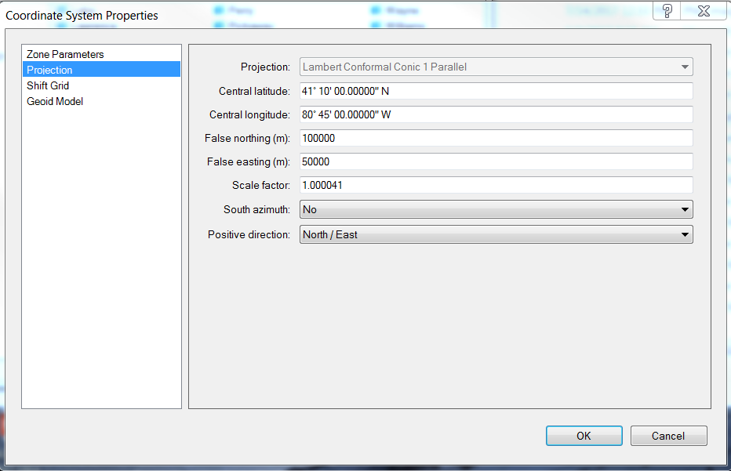
Coordinates 101
MAHONING
A
PROJECTIONS ARE DESIGNED BASED ON THE TOPOGRAPHIC SLOPE OF THE COUNTY
COUNTIES THAT SLOPE PREDOMINANTLY NORTH-SOUTH RECEIVE LAMBERT CONFORMAL CONIC PROJECTIONS

Slide 52
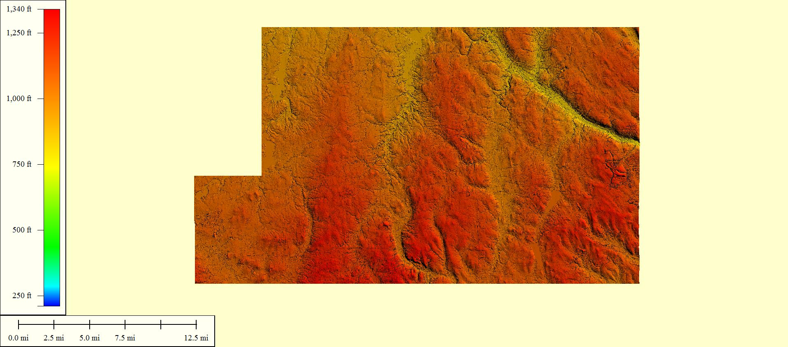
Coordinates 101
A

Slide 53
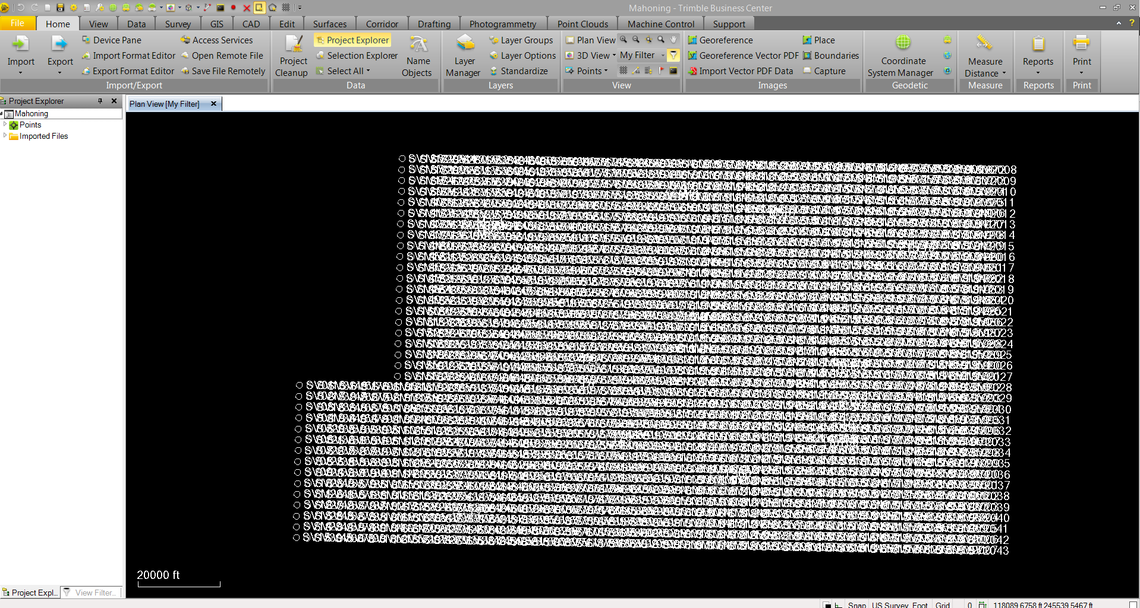
Coordinates 101
A

Slide 54
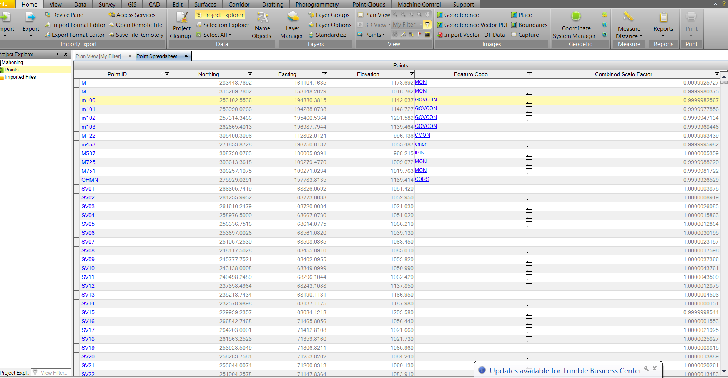
Coordinates 101
A

Slide 55

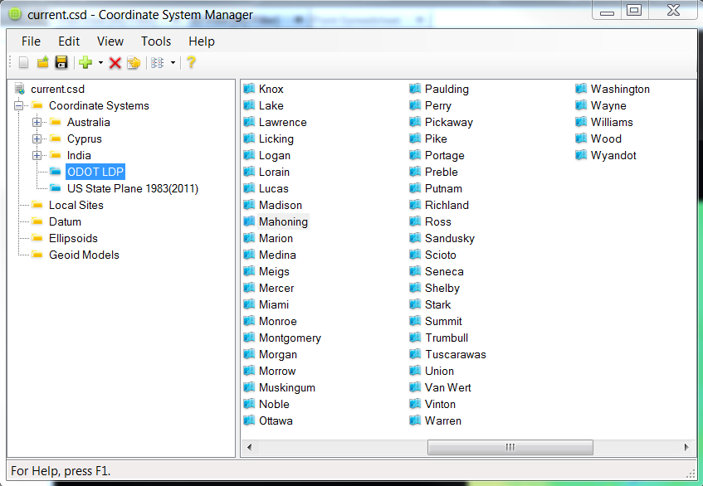
Coordinates 101
A

Slide 56
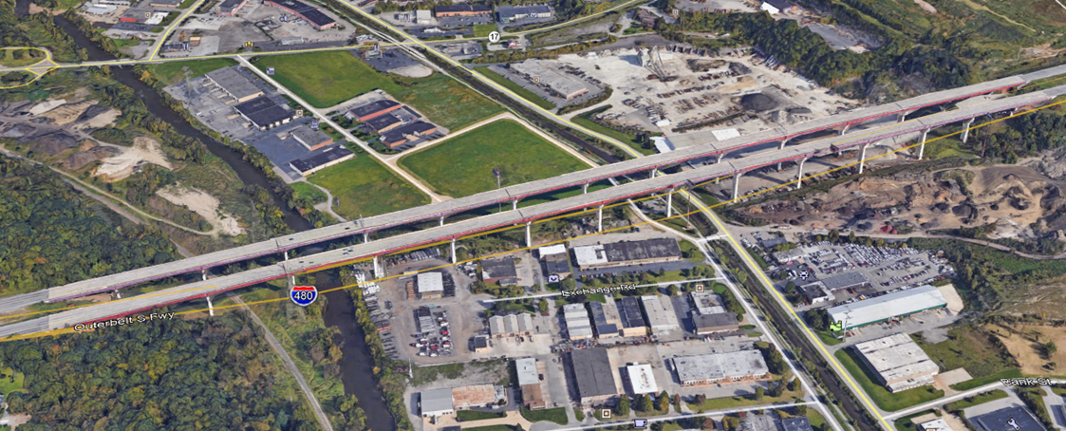
Coordinates 101
Cuyahoga County
I-480 Valley View Bridge
A
I-480 BRIDGE SPAN
 | Grid | Ground | Diff. | feet per mile | parts per million | 1/
STATE PLANE | 4191.688 | 4192.004 | -0.316 | -0.398 | -75 | 13266
20 PPM | 4191.920 | 4192.004 | -0.084 | -0.106 | -20 | 49905
LDP | 4191.995 | 4192.004 | -0.009 | -0.011 | -2 | 465778

Slide 57
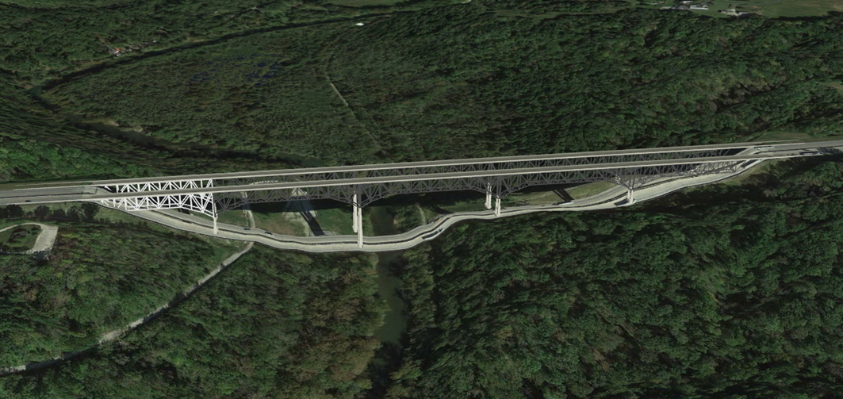
Coordinates 101
Warren County
A
JERIMIAH MORROW BRIDGE
 | Grid | Ground | Diff. | feet per mile | parts per million | 1/
STATE PLANE | 2224.093 | 2224.317 | -0.224 | -0.532 | -101 | 9930
20 PPM | 2224.272 | 2224.317 | -0.045 | -0.107 | -20 | 49429
LDP | 2224.313 | 2224.317 | -0.004 | -0.009 | -2 | 556079

Slide 58
Coordinates 101
589827.36
1764013.00
845.279
What is this?
Project Control
Positioning Method: ODOT VRS
Vertical Positioning
Orthometric Height Datum: NAVD 88
Geoid: Geoid 18
Horizontal Positioning:
Reference Frame: NAD 83 2011(2010.0)
Ellipsoid: GRS-80
Map Projection: LCC 2 Parallel
Coordinate System: Ohio South (3402)
Combined Scale factor: 0.99990888
Origin of Coordinate system: 0,0
NAD 27 or NAD 83?
Without Metadata these are just Numbers!
NAD 83?
HARN? CORS 96? 2011?
Ohio North or South?
NGVD 29? NAVD 88?
Scaled or Grid?

Slide 59
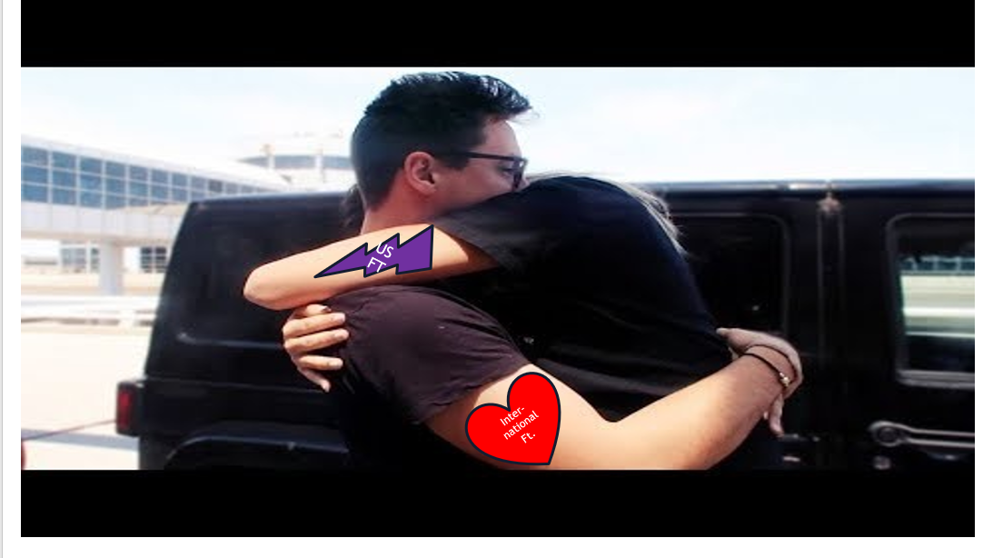
FOR A LIMITED TIME ONLY!

Slide 60
The problem
Two versions of same unit in current use
  “New” international foot and “old” U.S. survey foot
  “New” shorter than “old” by 2 ppm (0.01 ft per mile)
  A real problem with real costs
What’s in a name?
  “U.S. survey” versus “international”
Who is using U.S. survey feet?
  Surveyors exclusively, in most (not all) states
  But it impacts everyone
Notes:
It’s likely everyone watching this webinar knows about the problem: there are two nearly identical versions of the foot in current use in the U.S.;
They differ by 2 parts per million (ppm), or only 0.01 ft per mile, or slightly more than a tenth of an inch in a mile.
Despite (or actually because of) the very small difference, it has become a REAL problem with REAL costs.
What’s in a name? That which we call a “foot” by any other word would smell as… sweet? Maybe that’s not he best analogy for the foot…
“U.S. survey foot” sounds patriotic, is surveyor-centric…
“International foot” sounds like a New World Order, UN sanctioned sort of thing, with perhaps a whiff of socialism…
Is the name really part of the problem? I hope not, but emotion does play a role. We are not entirely rational creatures after all (myself included).
Surveyors are really the only users of the U.S. survey foot (sft). They are also among the very few who even know of its existence. In schools and colleges they only teach students about the official international foot (ift). However, because people use the products created by surveyors, they end up using the sft without even knowing it.
Want to have a conversation about this, get all of us on the same page. So I will present facts to facilitate informed discussion (sprinkled with some opinions…)

Slide 61

2 parts per million (ppm)
1,000,000.00 sft = 999,998.00 ift
10,000,000.00 sft = 9,999,980.00 ift
International → 1 ft = .3048 m
US → 1 ft = .30480061 m (approx.)
  frequently calculated by $\frac{1200}{3937}$
Notes:
It’s likely everyone watching this webinar knows about the problem: there are two nearly identical versions of the foot in current use in the U.S.;
They differ by 2 parts per million (ppm), or only 0.01 ft per mile, or slightly more than a tenth of an inch in a mile.
Despite (or actually because of) the very small difference, it has become a REAL problem with REAL costs.
What’s in a name? That which we call a “foot” by any other word would smell as… sweet? Maybe that’s not he best analogy for the foot…
“U.S. survey foot” sounds patriotic, is surveyor-centric…
“International foot” sounds like a New World Order, UN sanctioned sort of thing, with perhaps a whiff of socialism…
Is the name really part of the problem? I hope not, but emotion does play a role. We are not entirely rational creatures after all (myself included).
Surveyors are really the only users of the U.S. survey foot (sft). They are also among the very few who even know of its existence. In schools and colleges they only teach students about the official international foot (ift). However, because people use the products created by surveyors, they end up using the sft without even knowing it.
Want to have a conversation about this, get all of us on the same page. So I will present facts to facilitate informed discussion (sprinkled with some opinions…)

Slide 62
What’s impacted?
When does this matter?
  Not typically in lengths/distances
  But in published planar coordinate systems
Like what?
  SPCS and UTM are very popular and both fall victim to mix-ups
Why?
  Large false eastings and northings
Notes:
It’s likely everyone watching this webinar knows about the problem: there are two nearly identical versions of the foot in current use in the U.S.;
They differ by 2 parts per million (ppm), or only 0.01 ft per mile, or slightly more than a tenth of an inch in a mile.
Despite (or actually because of) the very small difference, it has become a REAL problem with REAL costs.
What’s in a name? That which we call a “foot” by any other word would smell as… sweet? Maybe that’s not he best analogy for the foot…
“U.S. survey foot” sounds patriotic, is surveyor-centric…
“International foot” sounds like a New World Order, UN sanctioned sort of thing, with perhaps a whiff of socialism…
Is the name really part of the problem? I hope not, but emotion does play a role. We are not entirely rational creatures after all (myself included).
Surveyors are really the only users of the U.S. survey foot (sft). They are also among the very few who even know of its existence. In schools and colleges they only teach students about the official international foot (ift). However, because people use the products created by surveyors, they end up using the sft without even knowing it.
Want to have a conversation about this, get all of us on the same page. So I will present facts to facilitate informed discussion (sprinkled with some opinions…)

