Slide 2
PLSO Fall Conference OCT 14-15, 2021
Notes:
Welcome and intro

Slide 3
A Day at the DOT

Slide 4
Todays Presentation
ODOT Updates: Raymond Foos (Central Office)
Major Pains of Major 2’s: Scott Hawkins District 03
“Did You Know”: Sara Morrisey District 01

Slide 5
Ohio single zone base layer SPCS 2022
Single State Plane Zone Base Layer for Large Scale GIS Applications “OGRIP”
Transverse Mercator Projection Scaled to the Topographic Surface
98% of State within 200 ppm or 1:5,000

Slide 6
SPCS 2022
2nd Layer: Low Distortion Layer
Based on County Boundaries
Goal was to have linear distortion reduced to 10 ppm or less

Slide 7
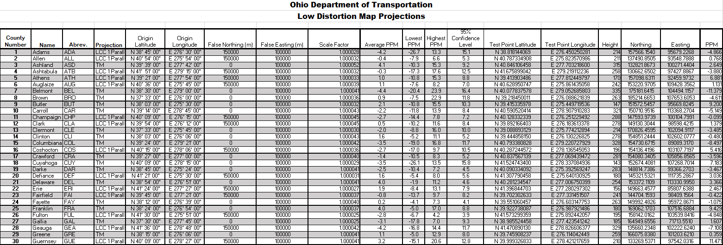
SPCS 2022

Slide 8
SPCS 2022
Low Distortion
Ground
surface
surface
Ellipsoid
Grid length greater
Typical State Plane
surface
than ellipsoidal length
surface
(distortion > 0)
Grid length less than
ellipsoidal length
(distortion < 0)
Typical State Plane Zone
width for balanced positive
and negative distortion
Dave Minkel and Michael Dennis
NGS/NOAA

